Slide 1


Building the SPPf model

Slide 2
The SPPf model is an extension of the basic SIRS disease model

Slide 3
S
I
R
Non-Immune
Infectious
Immune
The non-immune may become infected with malaria

Slide 4
S
I
R
Non-Immune
Infectious
Immune
The infected may recover naturally and develop immunity to malaria

Slide 5
S
I
R
Non-Immune
Infectious
Immune
This immunity may be lost over time

Slide 6
I_{n}
S
R
I_{a}
I_{c}
I_{s}
Non-Immune
Infectious
Immune
But infections can be sub-microscopic (I_{n}), asymptomatic (I_{a}) and clinical (I_{c}) with the potential to become severe (I_{s})

Slide 7
I_{n}
S
R
I_{a}
I_{c}
I_{s}
Non-Immune
Infectious
Immune
Natural recovery can occur with symptomatic infections becoming asymptomatic and eventually curing entirely (green arrows)

Slide 8
I_{n}
I_{a}
R
S
I_{c}
H
I_{s}
T_{h}
T_{o}
Non-Immune
Infectious
Immune
Some infections will be treated through the public health system (T_{h}) and others through the private sector (T_{o})

Slide 9
I_{n}
I_{a}
R
S
I_{c}
H
I_{s}
T_{h}
T_{o}
Non-Immune
Infectious
Immune
Treated infections will cure to a state where false positive test results will temporarily be possible due to the presence of the HRP2 antigen.

Slide 10
I_{n}
I_{a}
R
S
I_{c}
H
I_{s}
T_{h}
T_{o}
Non-Immune
Infectious
Immune
The immune are also susceptible to infection with a higher probability of developing an asymptomatic infection

Slide 11
I_{n}
I_{a}
R
S
I_{c}
H
I_{s}
T_{h}
T_{o}
Non-Immune
Infectious
Immune
It is possible have more than one infection at the same time (superinfection - orange arrows)

Slide 12
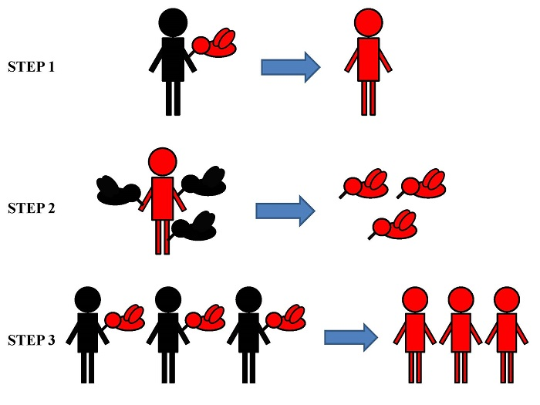
Biology
Environment
Demography
Health Systems Information
Geography
Economic Costs

Slide 13
How to develop an epidemiological-economic model?

Slide 14
Write equations to describe biological behaviour of malaria
Calibrate the model to existing environmental conditions
Use population and health systems data to create synthetic populations in silico that have features similar to real populations

Slide 15
Test out proposed interventions on the model
Incorporate cost data for each intervention
Analyse model output to make recommendations

Slide 16
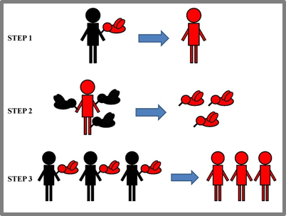
These elements are combined to project the costs for and rates of malaria in a geographic area of interest.
Biology
Health Systems Information
Demography
Geography
Economic Costs
Environment
Model

